Slide 1
12
Some Lessons from Capital Market History

Slide 2

Chapter 12 – Index of Sample Problems
Slide # 02 - 03 Dividend yield
Slide # 04 - 05 Capital gains yield
Slide # 06 - 07 Total return
Slide # 08 - 09 Nominal vs. real returns
Slide # 10 - 11 Risk premium
Slide # 12 - 13 Average return
Slide # 14 - 15 Variance
Slide # 16 - 17 Standard deviation
Slide # 18 - 23 Probability distributions
Slide # 24 - 26 Arithmetic vs. geometric averages

Slide 3
2: Dividend yield
The common stock of Abaco Co. is expected to pay $1.60 in dividends next year. Currently, the stock is selling for $38.90 a share.
What is the dividend yield?

Slide 4
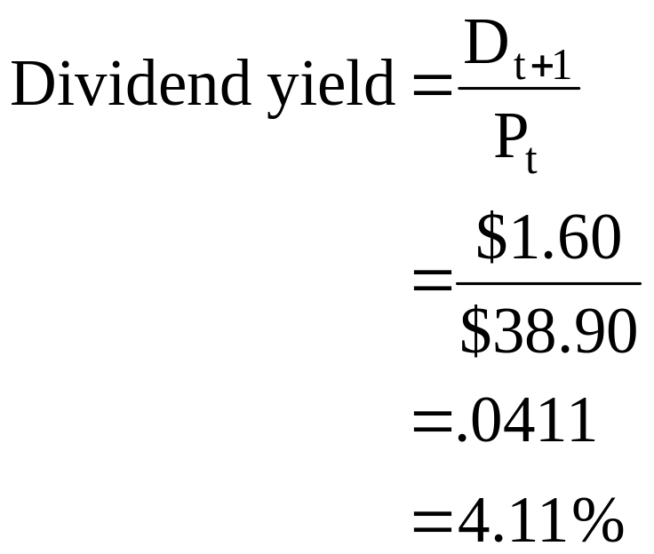
3: Dividend yield

Slide 5
4: Capital gains yield
Last year, you purchased shares of Baker and Sons, Inc. at a price of $28.42 a share. Since that time you have received $1.20 in dividends per share. Currently, the stock is selling for $31.18 per share.
What is the capital gains yield?

Slide 6
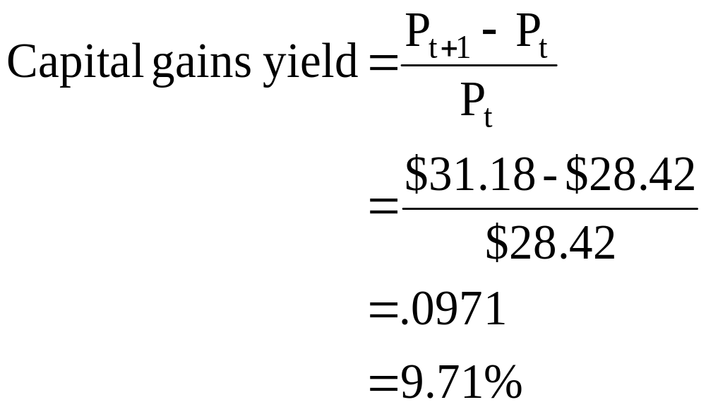
5: Capital gains yield

Slide 7
6: Total return
Zoma Enterprises pays $.80 a year as a dividend on their common stock. Currently, this stock sells for $28.12 a share. Last year at this time the stock was selling for $31.64 a share.
What is the total return on this stock in dollars?
What is the percentage total return?

Slide 8
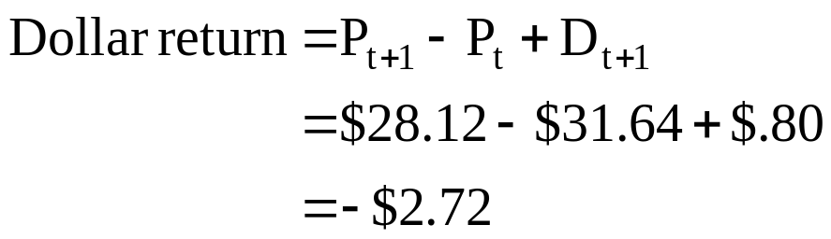
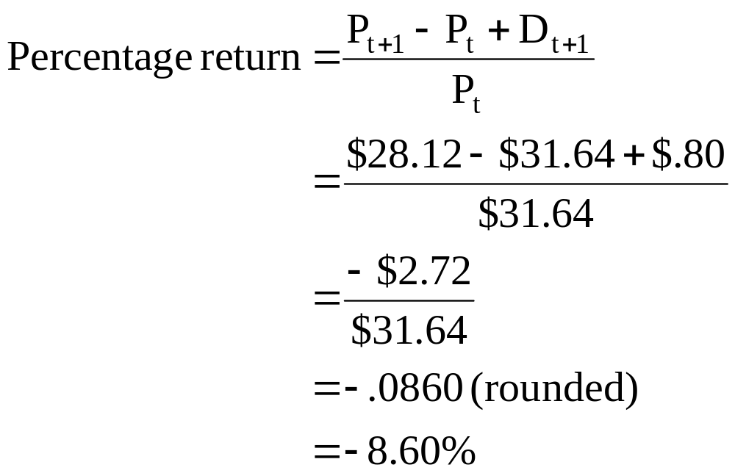
7: Total return

Slide 9
8: Nominal vs. real returns
Last year, you purchased shares of Benson and Judges, Inc. stock for $13.50 a share. Since then you received $.50 per share in dividends. Today, you sold your shares for $18.20 a share. The inflation rate for the period is 3.5%.
What is your nominal rate of return?
What is your real rate of return?

Slide 10
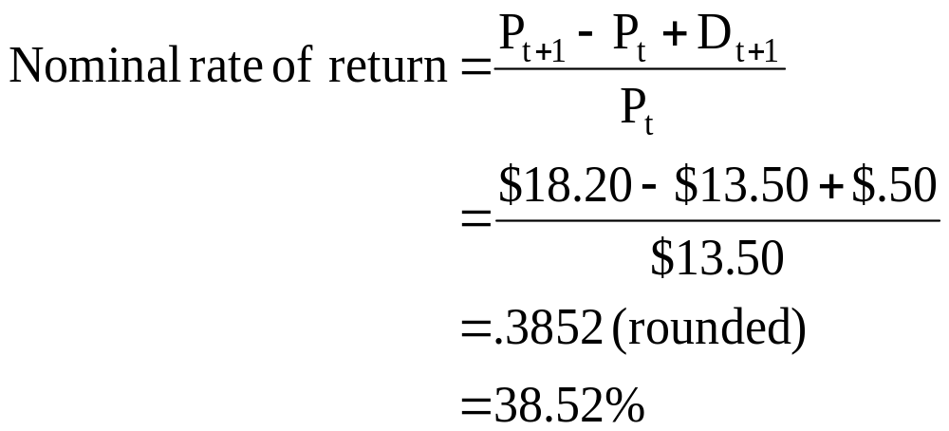
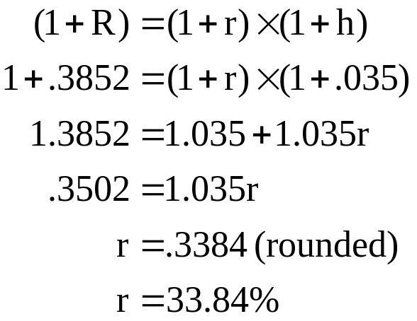
9: Nominal vs. real returns

Slide 11
10: Risk premium
Assume that the following are the average annual returns for the past decade:
Large-company stocks 9.6%
Long-term corporate bonds 5.8%
U.S. Treasury bills 2.5%
Inflation 1.9%
What is the risk premium on large-company stocks for this time period?

Slide 12
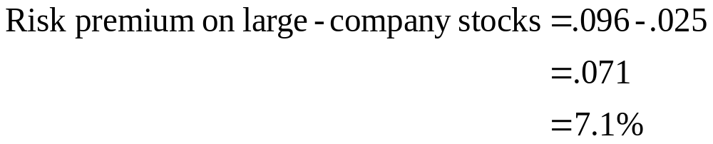
11: Risk premium

Slide 13
12: Average return
A stock returned 4.8%, 9.3%, 21.6%, -13.2% and 0.4% for the past five years, respectively.
What is the average rate of return for the past five years?

Slide 14
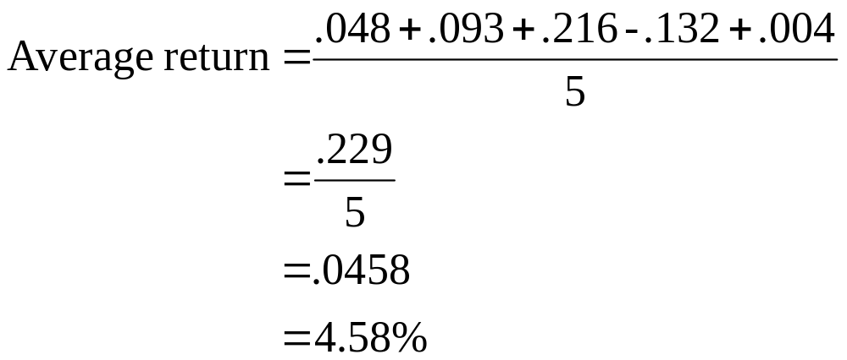
13: Average return

Slide 15
14: Variance
A stock returned 4.8%, 9.3%, 21.6%, -13.2% and 0.4% for the past five years, respectively.
What is the variance?

Slide 16
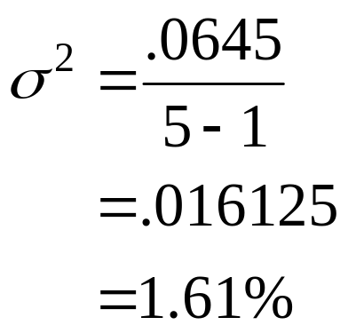
15: Variance
Actual Return | Average Return | Deviation | Squared Deviation
.048 | .0458 | .0022 | .0000
. 093 | .0458 | .0472 | .0022
.216 | .0458 | .1702 | .0290
-.132 | .0458 | -.1778 | .0316
.004 | .0458 | -.0418 | .0017
 | Totals | .0000 | .0645

Slide 17
16: Standard deviation
A stock returned 4.8%, 9.3%, 21.6%, -13.2% and 0.4% for the past five years, respectively.
The variance is .016125.
What is the standard deviation?

Slide 18
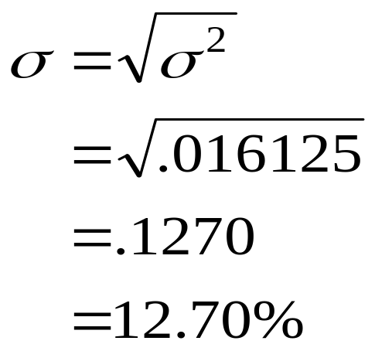
17: Standard deviation
The variance, σ², as computed previously, is .016125.

Slide 19
18: Probability distributions
A stock has an average rate of return of 4.58% and a standard deviation of 12.70%. Assume that the returns are normally distributed.
What range of returns would you expect to see 68% of the time?
95% of the time? 99% of the time?

Slide 20
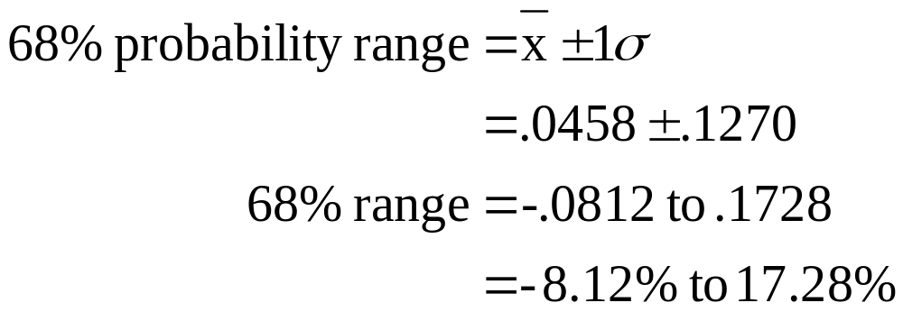
19: Probability distributions

Slide 21
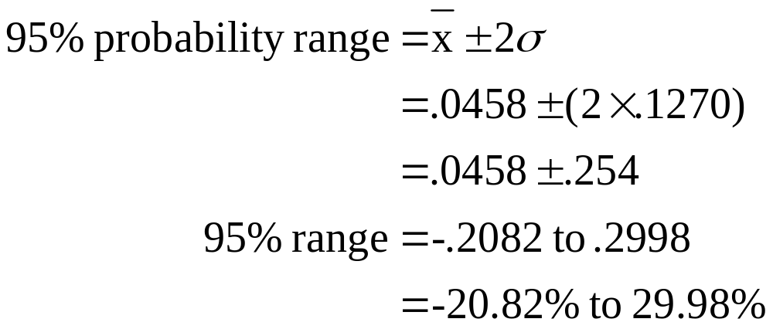
20: Probability distributions

Slide 22
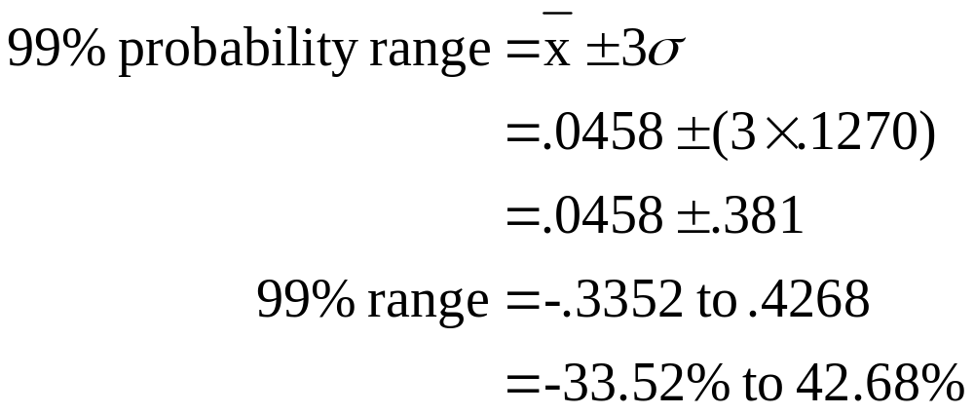
21: Probability distributions

Slide 23
22: Probability distributions
A stock has an average rate of return of 12.9% and a standard deviation of 15.3%. Assume the returns are normally distributed.
What is the probability that you will lose more than one-third of your investment in this stock in any one year?

Slide 24
23: Probability distributions
68% | .129 – (1 × .153) | -2.4% | .129 + (1 × .153) | 28.2%
95% | .129 – (2 × .153) | -17.7% | .129 + (2 × .153) | 43.5%
99% | .129 – (3 × .153) | -33.0% | .129 + (3 × .153) | 58.8%
The probability of losing more than one-third (33%)
of your investment in this stock in any one year is less than ½ of 1%.

Slide 25
24: Arithmetic vs. geometric averages
A stock has the following year-end prices and dividends.
Year Price Dividend
0 $38.16 ---
1 $39.43 $.60
2 $38.04 $.62
3 $45.09 $.65
4 $44.10 $.70
What are the arithmetic and geometric returns for this stock?

Slide 26
25: Arithmetic vs. geometric averages
Year | Price | Dividend | Annual return
0 | $38.16 | --- | ---
1 | $39.43 | $.60 | ($39.43 - $38.16 + $.60) ÷ $38.16 = 4.90%
2 | $38.04 | $.62 | ($38.04 - $39.43 + $.62) ÷ $39.43 = -1.95%
3 | $45.09 | $.65 | ($45.09 - $38.04 + $.65) ÷ $38.04 = 20.24%
4 | $44.10 | $.70 | ($44.10 - $45.09 + $.70) ÷ $45.09 = -0.64%

Slide 27
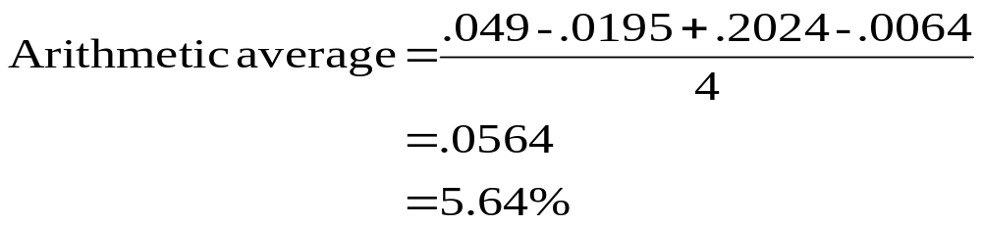
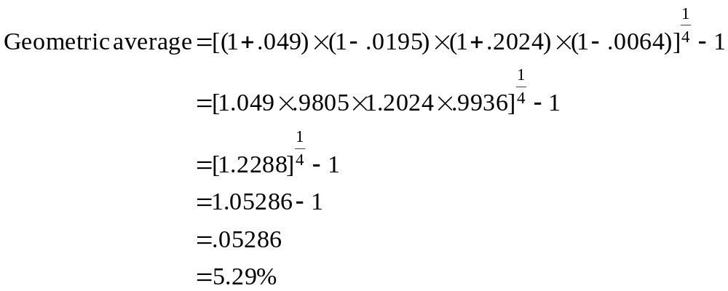
26: Arithmetic vs. geometric averages
Annual returns: 4.90%, -1.95%, 20.24% and -.64%

Slide 28
12
End of Chapter 12

